Slide 1
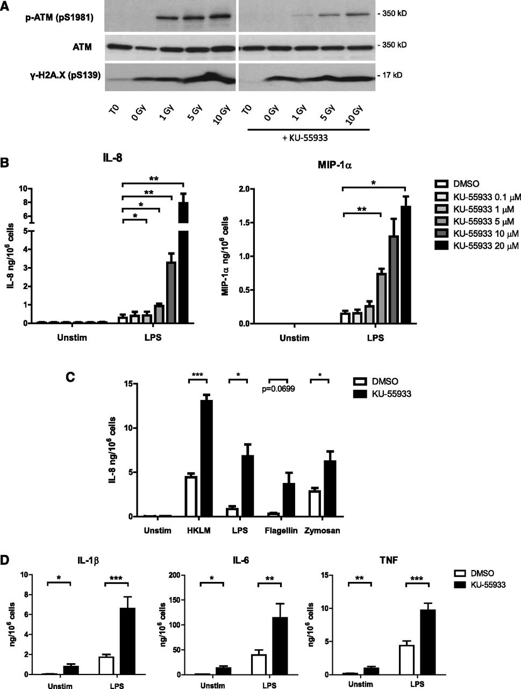

Neutrophil oxidative burst activates ATM to regulate cytokine production and apoptosis
C. J. Harbort,Paulo Vitor Soeiro-Pereira,Horst von Bernuth,Angela M. Kaindl,Beatriz Tavares Costa-Carvalho,Antonio Condino-Neto,Janine Reichenbach,Joachim Roesler,Arturo Zychlinsky,Borko Amulic, Neutrophil oxidative burst activates ATM to regulate cytokine production and apoptosis, Blood, 2015, Figure 1
Copyright © 2024 American Society of Hematology
Notes:
Figure Legend:
Inhibition of ATM activity in neutrophils increases proinflammatory cytokine production. (A) Western blot of ATM, phosphorylated ATM, and γ-H2A.X in lysates from neutrophils exposed to γ irradiation and incubated for 1 hour with and without 10 µM ATM inhibitor KU-55933. (B) Neutrophil IL-8 (n = 4) and MIP-1α (n = 3) production in response to LPS stimulation in the presence of increasing KU-55933 concentration. Isolated peripheral blood neutrophils from healthy donors were incubated with ATM inhibitor and stimulated with LPS for 18 hours. Cytokine concentrations in supernatants were measured by ELISA. (C) Neutrophil IL-8 production in response to 18-hour stimulation with flagellin (1 μg/mL), LPS (100 ng/mL), opsonized zymosan (10 μg/mL), or heat-killed L monocytogenes (HKLM, MOI = 100) in the presence of KU-55933 (10 μM) (n = 3-4). (D) Monocyte cytokine production in response to LPS stimulation in the presence of KU-55933. Isolated peripheral blood monocytes from healthy donors (n = 10) were incubated with KU-55933 (10 μM) and stimulated for 18 hours with LPS. (B-D) Data are presented as the mean ± standard error of the mean (SEM) of compiled experiments. Asterisks indicate significant increases: *P < .05, **P < .01, ***P < .001 by paired Student t test.

Slide 2
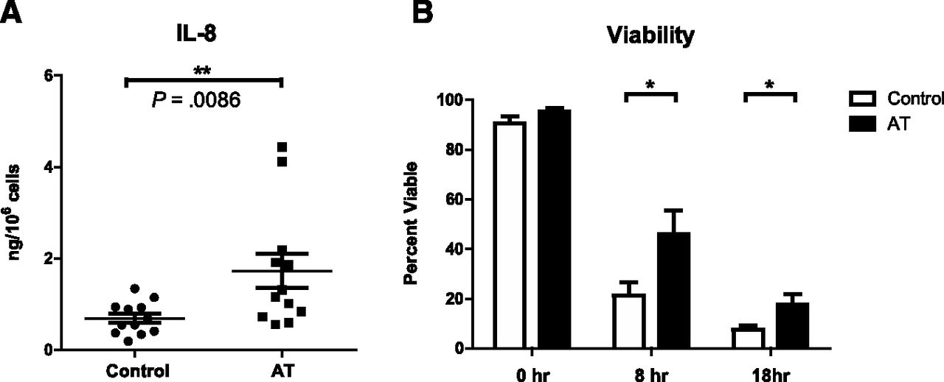
Neutrophil oxidative burst activates ATM to regulate cytokine production and apoptosis
C. J. Harbort,Paulo Vitor Soeiro-Pereira,Horst von Bernuth,Angela M. Kaindl,Beatriz Tavares Costa-Carvalho,Antonio Condino-Neto,Janine Reichenbach,Joachim Roesler,Arturo Zychlinsky,Borko Amulic, Neutrophil oxidative burst activates ATM to regulate cytokine production and apoptosis, Blood, 2015, Figure 2
Copyright © 2024 American Society of Hematology
Notes:
Figure Legend:
Primary neutrophils isolated from AT patients produce more IL-8 and have a prolonged lifespan. (A) IL-8 production from LPS-stimulated peripheral blood neutrophils isolated from AT patients (mean = 1.73 ng, n = 12) or healthy controls (mean = 0.69 ng, n = 12) 18 hours after stimulation (P = .0086, Mann-Whitney U test). IL-8 concentrations in supernatants were measured by ELISA and normalized to cell number. Data are plotted as mean ± SEM. (B) 18-hour viability curve of primary neutrophils isolated concurrently from AT patients (n = 5-7) and healthy controls (n = 6-8). At the indicated time points, neutrophils were collected and stained with PE-Annexin V and PI for viability. 10 000 cells per condition were analyzed by flow cytometry. Annexin V/PI-double-negative cells were defined as viable. Data are plotted as mean ± SEM. Asterisks indicate significant increases: *P < .05, **P < .01, ***P < .001 by paired Student t test.

Slide 3
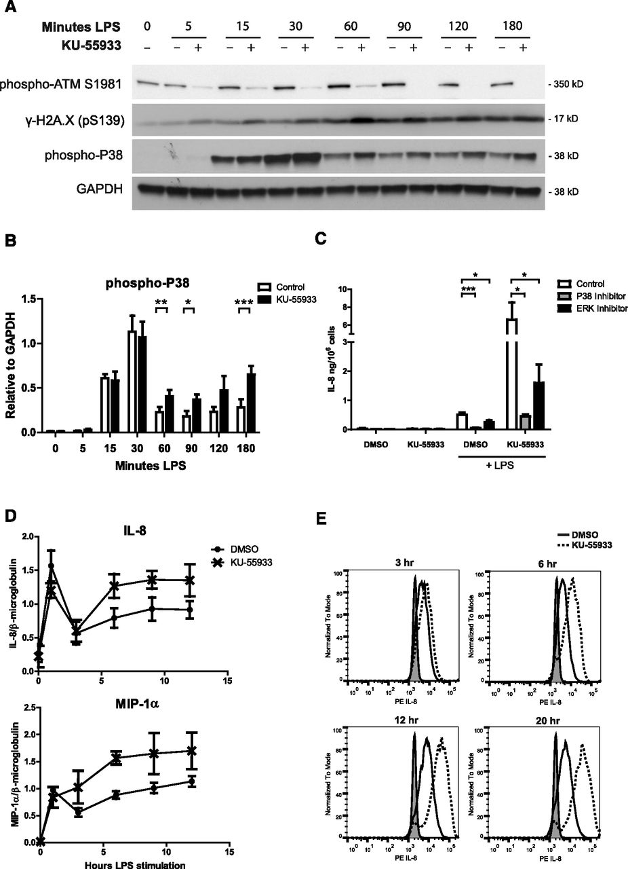
Neutrophil oxidative burst activates ATM to regulate cytokine production and apoptosis
C. J. Harbort,Paulo Vitor Soeiro-Pereira,Horst von Bernuth,Angela M. Kaindl,Beatriz Tavares Costa-Carvalho,Antonio Condino-Neto,Janine Reichenbach,Joachim Roesler,Arturo Zychlinsky,Borko Amulic, Neutrophil oxidative burst activates ATM to regulate cytokine production and apoptosis, Blood, 2015, Figure 3
Copyright © 2024 American Society of Hematology
Notes:
Figure Legend:
ATM inhibition increases p38 activation as well as cytokine transcription and production in stimulated neutrophils. (A) Western blot analysis of phosphorylation of ATM, histone H2A.X, and p38 in neutrophil lysates over a 180-minute time course of LPS stimulation with and without 10 µM KU-55933, representative blot of 4 experiments. (B) Relative levels of phospho-p38 quantified by densitometry in ImageJ software. Data are expressed as signal relative to the loading control GAPDH (n = 4). (C) Effect of p38 and ERK inhibitors on neutrophil IL-8 production in the presence of KU-55933 in response to LPS stimulation. IL-8 concentration in supernatants was measured after 18 hours of stimulation (n = 5) (D). Quantitative real-time PCR analysis of relative IL-8 and MIP-1α transcripts in cDNA from neutrophils stimulated with LPS with and without KU-55933. mRNA was isolated from LPS-stimulated neutrophils at the indicated time points, converted to cDNA, and analyzed by qPCR in triplicate (n = 3). Data are expressed as the relative amount of cytokine transcript divided by the relative amount of housekeeping gene β2-microglobulin (n = 3). Relative transcript amounts were calculated using a standard curve made from serial dilutions of a pooled sample. Data were analyzed using StepOnePlus software. (D) Intracellular IL-8 staining of LPS-stimulated neutrophils in the presence of KU-55933. Neutrophils were incubated with Brefeldin A to block secretion and stimulated with LPS with or without ATM inhibitor. At the indicated time points, cells were fixed and stained with an anti-IL8 antibody and analyzed by flow cytometry. At least 10 000 cells were analyzed per sample. Gray fill represents unstimulated neutrophils, the solid line represents LPS-stimulated dimethyl sulfoxide control, and the dashed line represents LPS-stimulated with 10 µM KU-55933. (B-D) Data are presented as the mean ± SEM of compiled experiments. Asterisks indicate significance: *P < .05, **P < .01, ***P < .001 by paired Student t test.

Slide 4
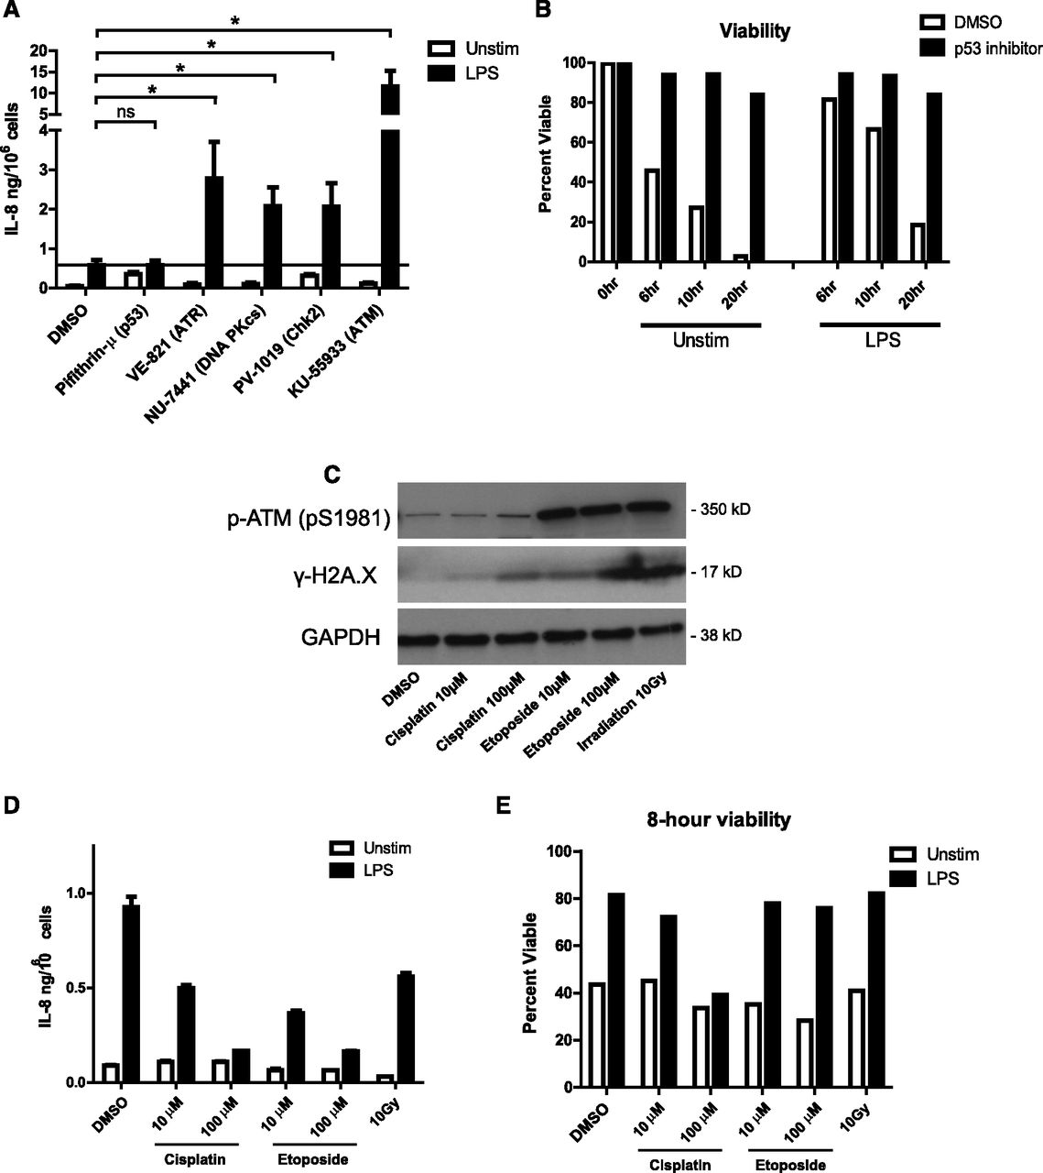
Neutrophil oxidative burst activates ATM to regulate cytokine production and apoptosis
C. J. Harbort,Paulo Vitor Soeiro-Pereira,Horst von Bernuth,Angela M. Kaindl,Beatriz Tavares Costa-Carvalho,Antonio Condino-Neto,Janine Reichenbach,Joachim Roesler,Arturo Zychlinsky,Borko Amulic, Neutrophil oxidative burst activates ATM to regulate cytokine production and apoptosis, Blood, 2015, Figure 4
Copyright © 2024 American Society of Hematology
Notes:
Figure Legend:
Activation of the DNA damage response downregulates neutrophil cytokine production. (A) Neutrophil IL-8 production in response to LPS stimulation in the presence of inhibitors of DNA damage-response proteins. Neutrophils were incubated with the indicated inhibitors (inhibitor targets in parentheses) and stimulated 18 hours with LPS in triplicate. IL-8 concentrations in supernatants were measured by ELISA. Data are plotted as the mean ± SEM of compiled experiments (n = 5). The black line represents the amount of IL-8 produced by LPS-stimulated control cells. (B) Neutrophil viability time course in the presence of p53 inhibitor pifithrin-µ (1 µM) measured by PE-annexin V/PI staining, as before. (C) Western blot analysis of phosphorylation of ATM and histone H2A.X in neutrophil lysates made after 1 hour of treatment with cisplatin, etoposide, and γ-irradiation. (D) Neutrophil IL-8 production in response to 18-hour LPS stimulation after 1 hour exposure to the indicated DNA damage–inducing agents. Data are plotted as the mean ± standard deviation. Results are representative of 3 experiments. (E) Neutrophil viability after 1 hour of incubation with indicated DNA damage–inducing treatment followed by 8 hours of stimulation with LPS or left unstimulated. Viability was measured as described by PE-annexin V/PI staining. Asterisks indicate significance: *P < .05, **P < .01, ***P< . 001 by paired Student t test.

Slide 5
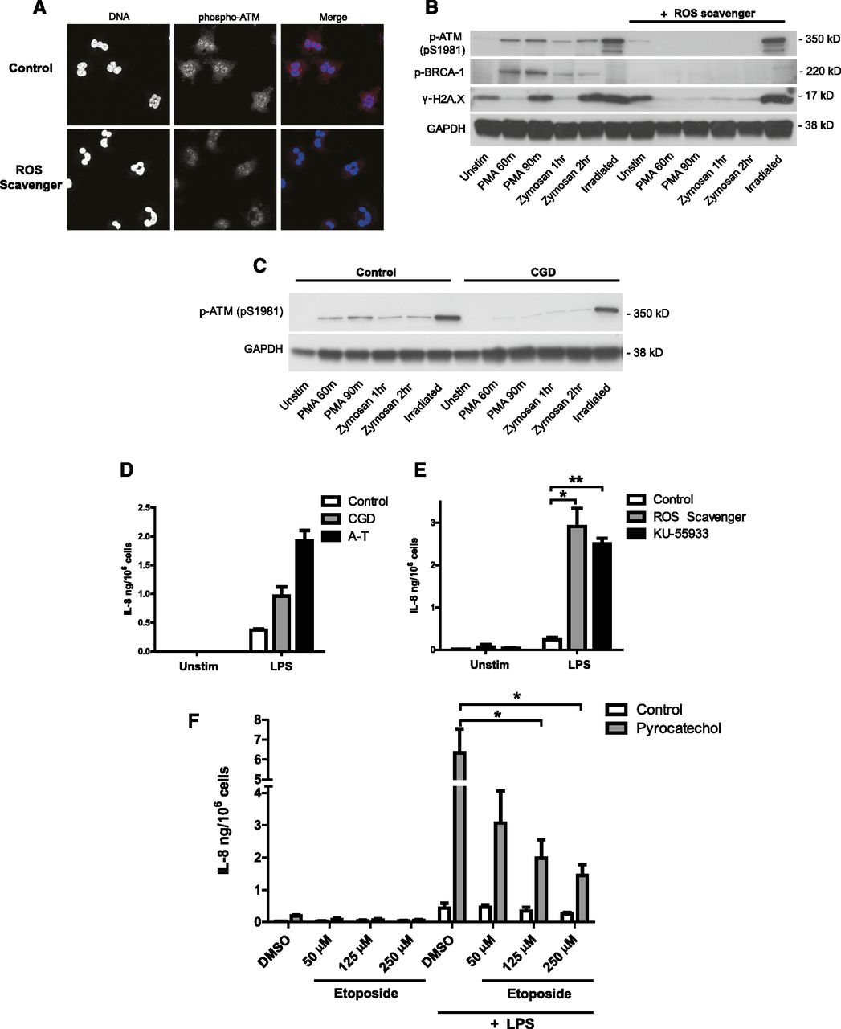
Neutrophil oxidative burst activates ATM to regulate cytokine production and apoptosis
C. J. Harbort,Paulo Vitor Soeiro-Pereira,Horst von Bernuth,Angela M. Kaindl,Beatriz Tavares Costa-Carvalho,Antonio Condino-Neto,Janine Reichenbach,Joachim Roesler,Arturo Zychlinsky,Borko Amulic, Neutrophil oxidative burst activates ATM to regulate cytokine production and apoptosis, Blood, 2015, Figure 5
Copyright © 2024 American Society of Hematology
Notes:
Figure Legend:
Neutrophil oxidative burst activates the DNA damage response and regulates cytokine production. (A-D) NADPH oxidase-derived ROS activates the DNA damage response in stimulated neutrophils. (A) Phospho-ATM (red) and DNA (blue) staining of healthy neutrophils activated with PMA in the presence of 30 μM ROS scavenger pyrocatechol. neutrophils were stimulated for 90 minutes with PMA to induce ROS production, fixed, permeabilized, stained with anti-pATM (pS1981) antibody, and visualized by confocal microscopy. (B-D) Western blot analysis of DNA damage-response activation in lysates from neutrophils stimulated with PMA, opsonized zymosan, or 10 Gy irradiation in the absence or presence of pyrocatechol (B), or isolated from control and CGD patient (C). (D-E) IL-8 production from neutrophils deficient in ATM activity and ROS production. (D) IL-8 production from neutrophils isolated concurrently from a CGD patient, an AT patient, and a healthy control after 18 hour of LPS stimulation (single experiment). Data are plotted as the mean ± SEM of triplicate stimulations. (E) IL-8 production from healthy control neutrophils incubated with ROS scavenger pyrocatechol or ATM inhibitor KU-55933, and stimulated for 18 hours with LPS (n = 3). IL-8 concentration in supernatants was measured by ELISA. (F) IL-8 production from neutrophils incubated with pyrocatechol, pretreated for 1 hour with indicated concentrations of etoposide, and stimulated for 18 hours with LPS (n = 3). (E-F) Data are presented as the mean ± SEM of compiled experiments. Asterisks indicate significance: *P < .05, **P < .01, ***P < .001 by paired Student t test.

